Slide 1

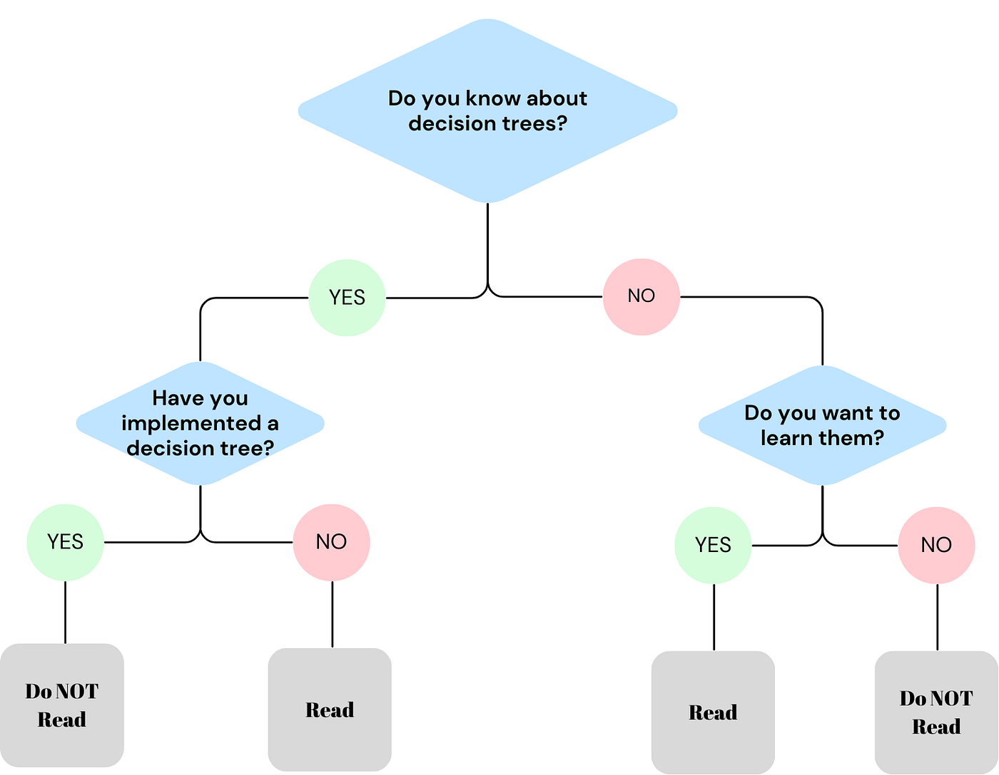
Decision Trees
Dr. David Raj M
Assistant Professor & Assistant Director, RAAC
School of Advanced Sciences
Vellore Institute of Technology, Chennai

Slide 2
Why Decision Trees?
Interpretability First: Unlike black-box models (e.g., deep neural nets), trees show exact decision paths/rules for every prediction – crucial for healthcare/finance where "why?" matters
No Data Prep Hassle: Handles categorical/numerical/missing data without scaling/normalization; nonlinear relationships naturally
Visual & Stakeholder-Friendly: lowchart-like trees explain to non-experts; feature importance ranks what drives decisions
Fast & Intuitive: Quick training, human-like if-then reasoning; baseline for ensembles (Random Forest fixes weaknesses)

Slide 3
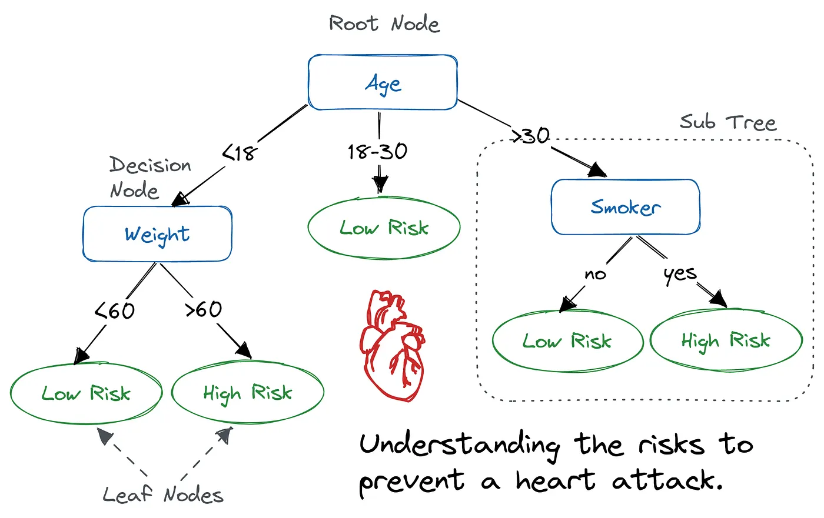
Decision Trees Basics
root → decisions → leaves
Root node: First rule splits data;
decision nodes guide via rules;
leaf nodes give final class

Slide 4
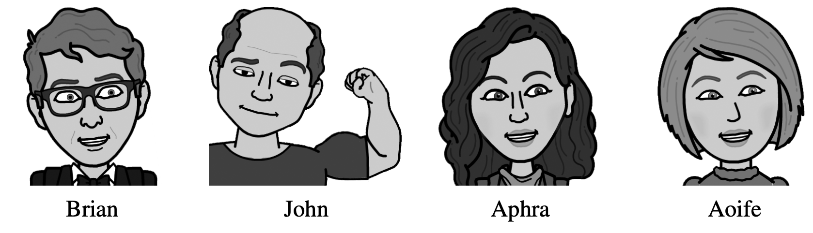
Example: Guess Who
Cards showing character faces and names for the Guess Who game.

Slide 5
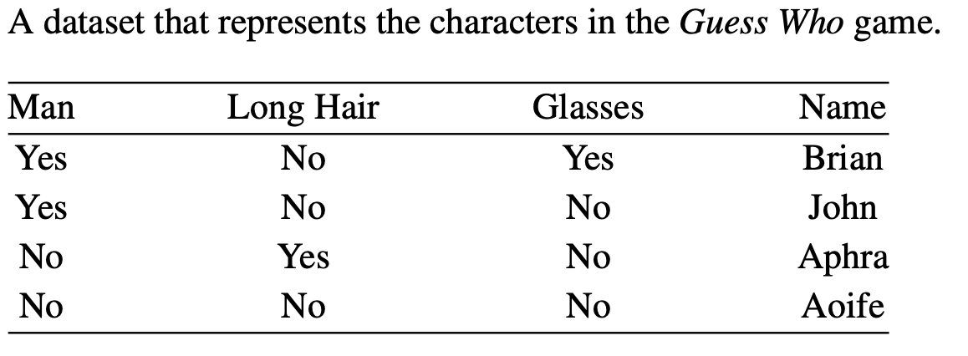

Slide 6
Lets Play
Now, imagine that we have picked one of these cards and you have to guess which one by asking questions. Which of the following questions would you ask first?
1. Is it a man?
2. Does the person wear glasses?

Slide 7
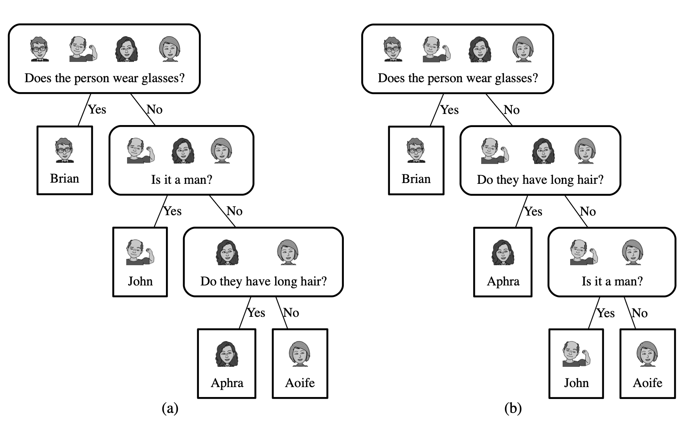

The different question sequences that can follow in a game of Guess Who beginning with the question
Does the person wear glasses?
The average number of questions you have to ask per game is

Slide 8
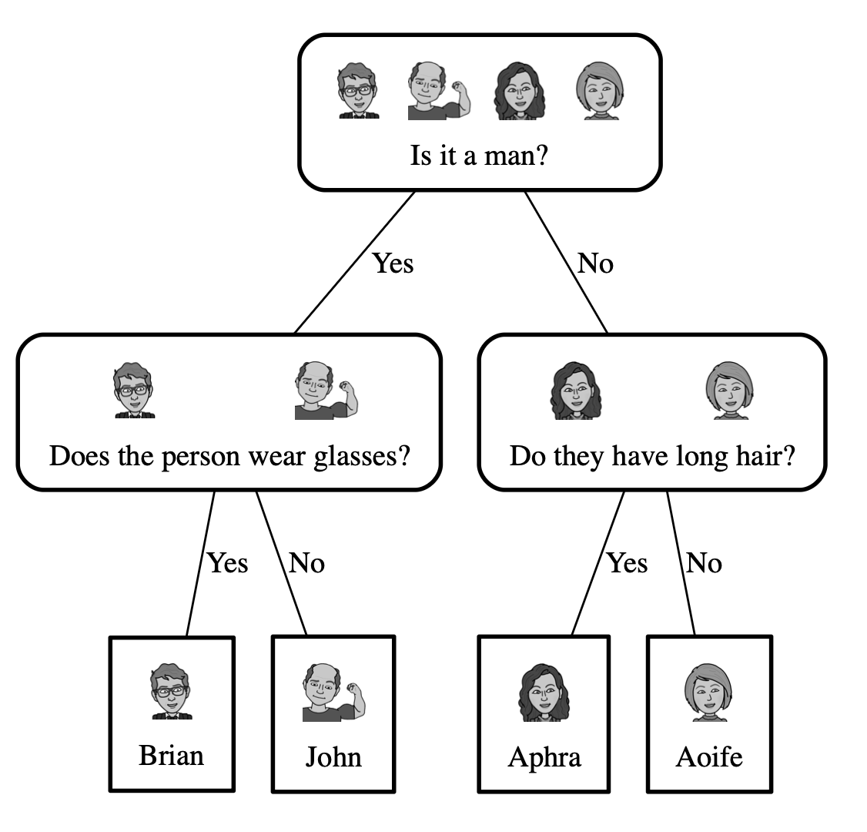

No matter what question you ask, the answer is always
either yes or no, but, on average, an answer to Question 1 seems to carry more information
than an answer to Question 2.
The average number of questions you have to ask per game is
Notes:
This is not because of the literal message in the answer (either yes or no). Rather, it is because of the way that the answer to each question splits
the character cards into different sets based on the value of the descriptive feature the ques-
tion is asked about (MAN, LONG HAIR or GLASSES) and the likelihood of each possible
answer to the question.

Slide 9
An answer to Question 1, Is it a man?, splits the game domain into two sets of equal size
One of these sets contains the solution, which leaves you with just one more question to ask to finish the game.
Notes:
This is not because of the literal message in the answer (either yes or no). Rather, it is because of the way that the answer to each question splits
the character cards into different sets based on the value of the descriptive feature the ques-
tion is asked about (MAN, LONG HAIR or GLASSES) and the likelihood of each possible
answer to the question.

Slide 10
The Big Idea
So, the big idea here is to figure out which features are the most informative ones to
ask questions about by considering the effects of the different answers to the questions,
in terms of how the domain is split up after the answer is received and the likelihood of each of the answers.

Slide 11
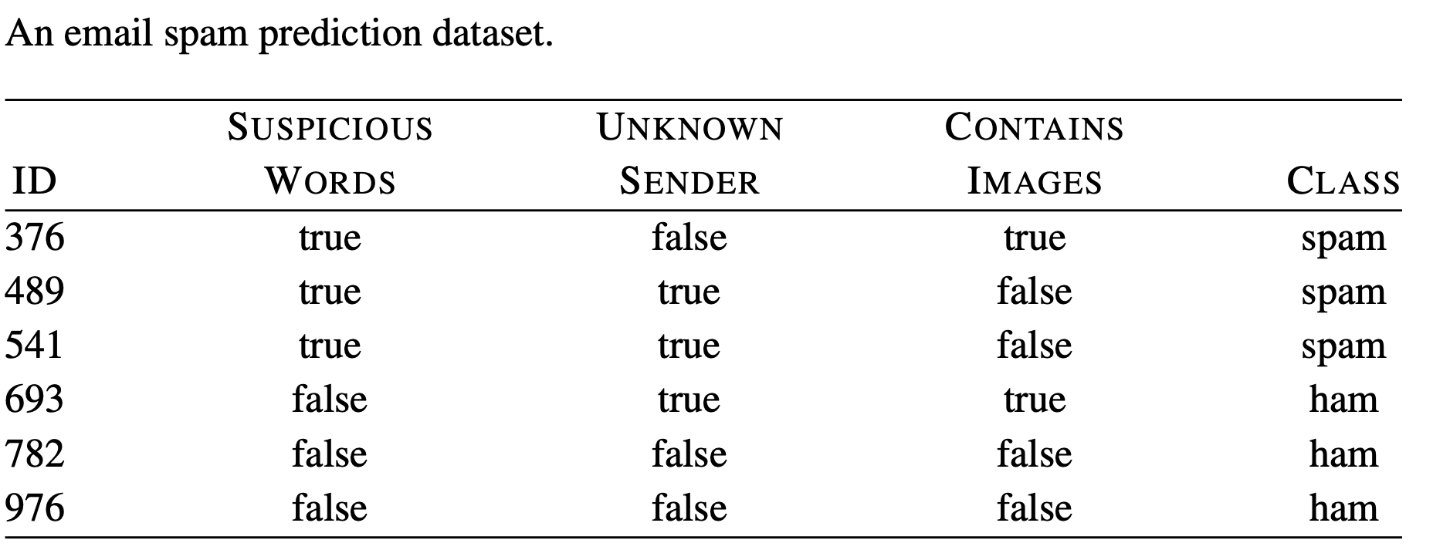
Another Example
Consider the following data set

Slide 12
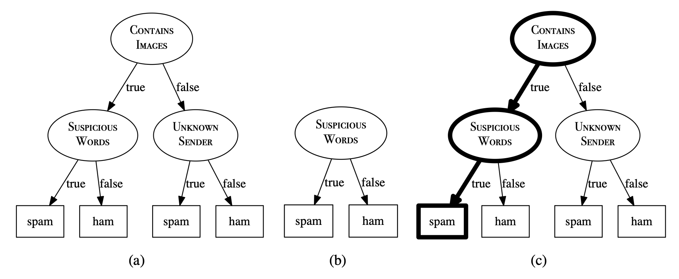

Slide 13
Handles nonlinear relationships (unlike linear/logistic regression)
Structure: Iterative decisions like human reasoning, easy for non-technical users

Slide 14
Entropy & Impurity Measures
Entropy: Measure of Disorder/uncertainty
0 (pure) to 1 (max impure, e.g., equal classes)
For example,
  an entropy value of 0 will be assigned to a dataset if all of the samples in it belong to one class, that is, the dataset is homogenous.
  On the other hand, if the dataset has samples that belong equally to two classes, then the entropy value will be 1 because given a new instance it is equally difficult to say which class it will belong to.

Slide 15
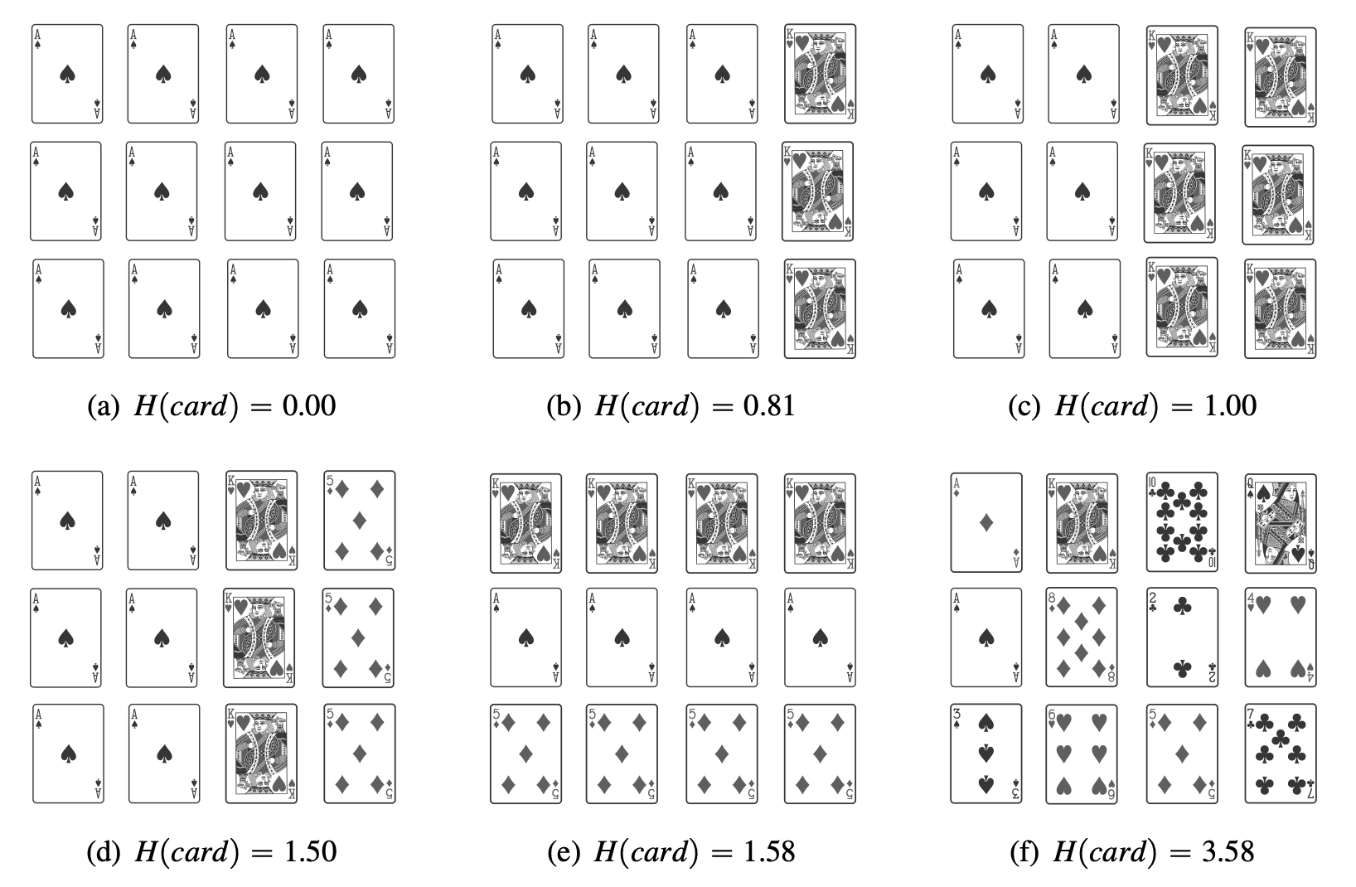
Notes:
if you were to randomly select a card from
the set shown in Figure(a) , you would have zero uncertainty, as you would know for
sure that you would select an ace of spades. So, this set has zero entropy.
Suppose if you were to randomly select an element from the set in Figure (f) , you would be very
uncertain about any prediction as there are 12 possible outcomes, each of which is equally
likely. This is why this set has very high entropy.

Slide 16
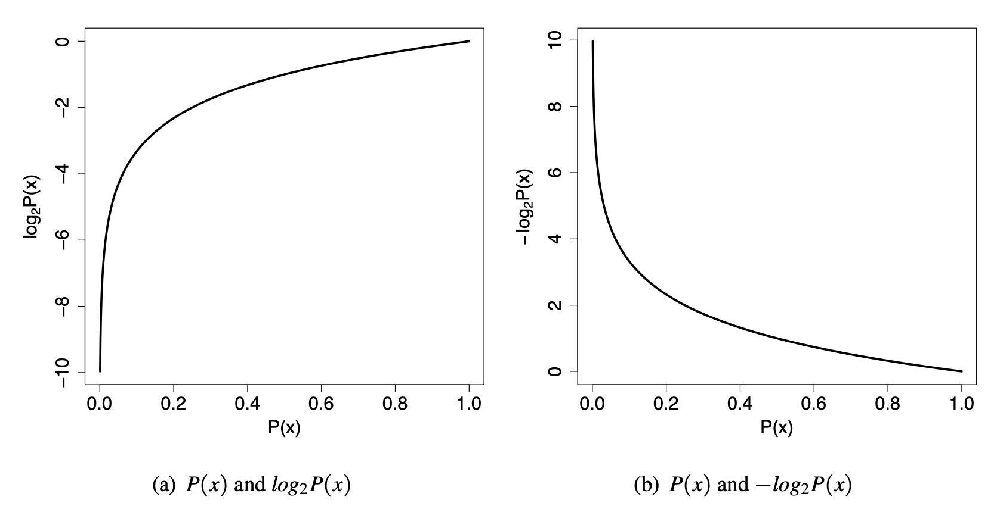
An outcome with a large probability should map to a low entropy value, and an outcome with a small probability should map to a large entropy value.
The mathematical logarithm, or log, function does almost exactly the transformation that we need.

Slide 17
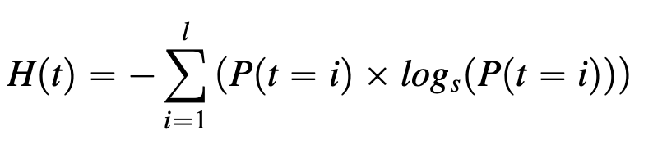
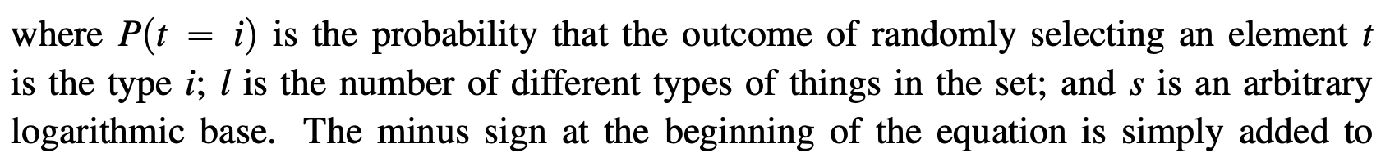

Slide 18
Information Gain: Information gain increases as entropy decreases and we become more certain about a decision.
Information gain is useful for telling us which attribute in a set of training features is most useful in distinguishing between the classes by quantifying the importance of a given attribute.
It measures how well a given attribute can separate the training set.
Information Gain = Entropy of the full dataset — Entropy of the dataset given a feature

Slide 19
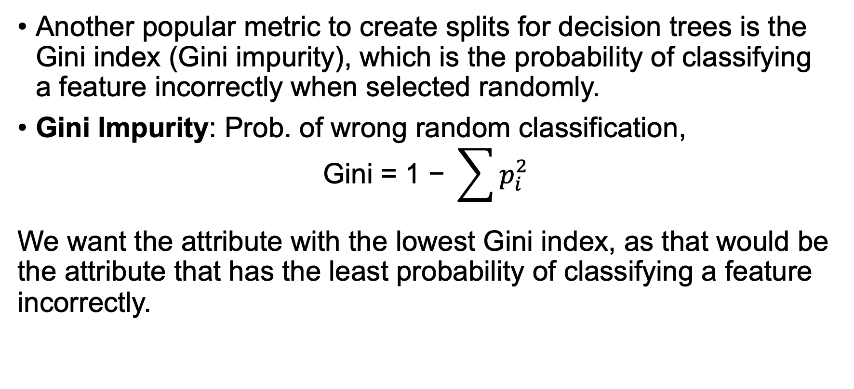
Gini Index
Another popular metric to create splits for decision trees is the Gini index (Gini impurity), which is the probability of classifying a feature incorrectly when selected randomly.
Gini Impurity: Prob. of wrong random classification,
$$\text{Gini}\text{ = 1 − }\sum{p_{i}^{2}}$$
We want the attribute with the lowest Gini index, as that would be the attribute that has the least probability of classifying a feature incorrectly.

Slide 20
General Steps to Grow Decision Trees
Use the entire dataset as the root node.
Use either information gain, Gini Index or other metrics to identify the best attribute to split the dataset. This is the new ‘decision node’
Divide the dataset into the subsets based on the possible values of the selected attribute (in Step 2)
Repeat the above steps for all the subsets created until all the subsets of the data belong to the same class or splitting the dataset further isn’t possible.

Slide 21
Interpretation
Interpreting decision trees is straightforward.
Starting from the root node, the decision nodes are selected based on some attribute selection criteria (such as information gain or Gini index).
Depending on the algorithm, the attribute is selected either to maximize information gain or minimize Gini index.

